Slide 1



Importing ONIX-PL Licenses
National Taiwan University
Sept. 17, 2019
Yoel Kortick. Senior Librarian

Slide 2
Contents
Introduction
ONIX Fields Mapping to Alma
Create an Alma license by importing an ONIX-PL license

Slide 3
Introduction
It is possible to import ONIX-PL (ONline Information eXchange for Publication Licenses) licenses to Alma.
These licenses include DLF (Digital Library Federation) standards.
Alma maps fields from the ONIX-PL XML file to fields in the DLF-based license template.

Slide 4
ONIX Fields Mapping to Alma - Alma Fields Mapped to Yes
For a list of fields mapped from the XML input file of the license to the field in the Alma license see ONIX Fields Mapping to Alma
If any of the license term fields in the next two slides exist in the input file then Alma maps these terms to “Yes”

Slide 5
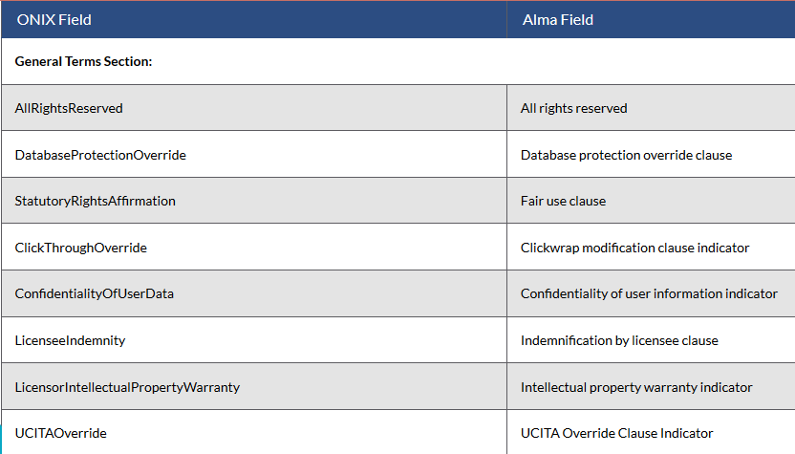
ONIX Fields Mapping to Alma - Alma Fields Mapped to Yes

Slide 6
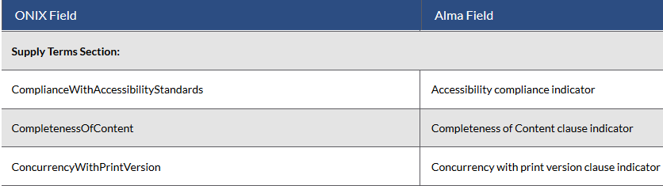
ONIX Fields Mapping to Alma - Alma Fields Mapped to Yes

Slide 7
ONIX Fields Mapping to Alma - ONIX href id Fields to Alma
If any of the terms listed in the next slide exist in the ONIX file, Alma maps the text from the href id field of the ONIX file to the Alma field.

Slide 8
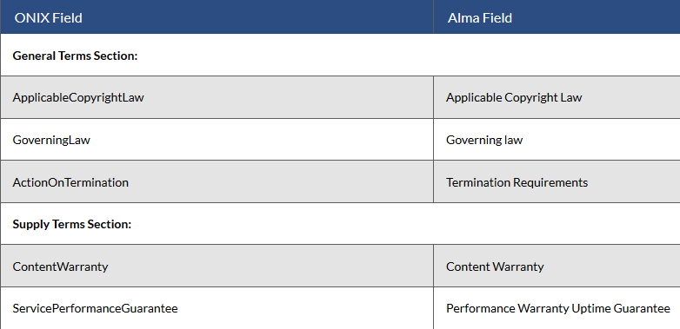
ONIX Fields Mapping to Alma - ONIX href id Fields to Alma

Slide 9
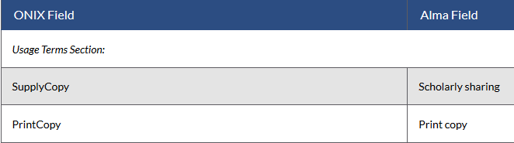
ONIX Fields Mapping to Alma - ONIX to Alma - ENUM
If either of the following terms exists in the ONIX file, Alma maps the field with the relevant ENUM (Permitted/ Prohibited/Silent/ Un-interpreted/ Not Applicable).

Slide 10
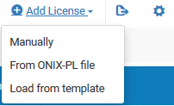
Create an Alma license by importing an ONIX-PL license
On the Licenses and Amendments page (Acquisitions > Acquisitions Infrastructure > Licenses), select Add License.
Select From “ONIX-PL file”.

Slide 11
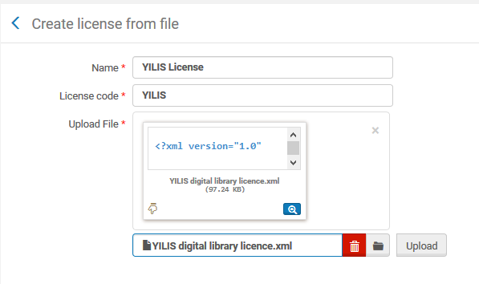
Create an Alma license by importing an ONIX-PL license
Enter the name and code of the license.
Select the file and click “Upload”.

Slide 12
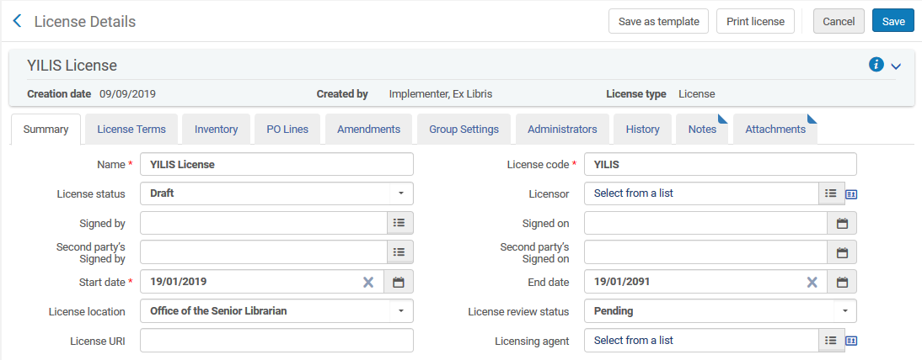
Create an Alma license by importing an ONIX-PL license
The license is created.
Let’s see where the start date and end date came from.

Slide 13
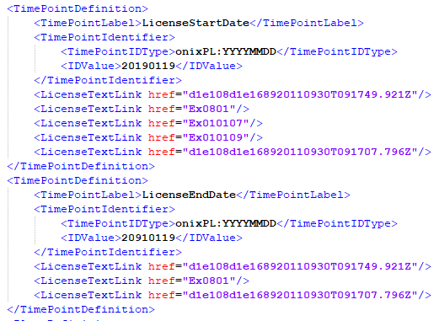
Create an Alma license by importing an ONIX-PL license
Here is the start date and end date in input file.

Slide 14
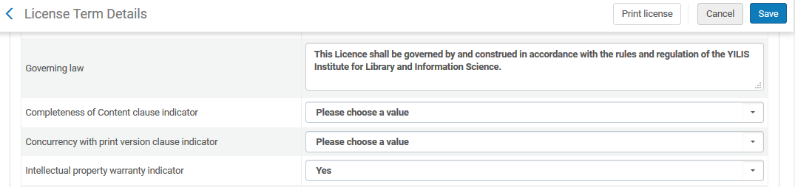
Create an Alma license by importing an ONIX-PL license
Here are some of the license terms in the created license
Let’s see where the “Governing Law” and “Intellectual property warranty indicator” came from.

Slide 15

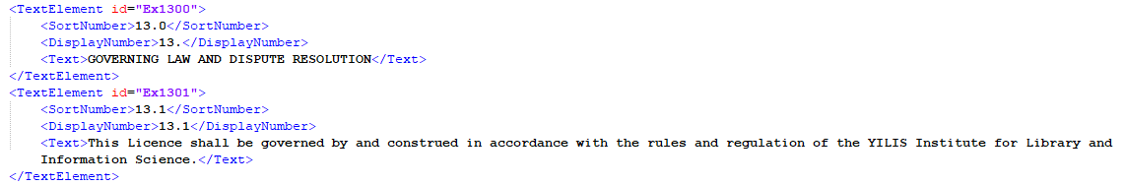
Create an Alma license by importing an ONIX-PL license
Here is the governing law in input file.

Slide 16
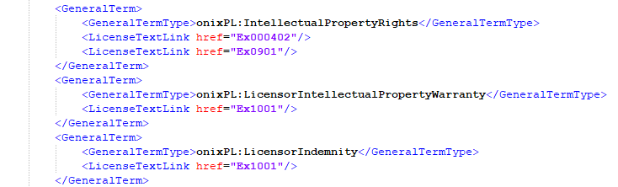
Create an Alma license by importing an ONIX-PL license
The “Intellectual property warranty indicator” has “Yes” because the term “LicensorIntellectualPropertyWarranty” exist in the input file

Slide 17
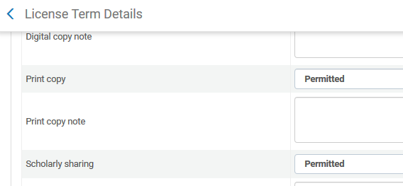
Create an Alma license by importing an ONIX-PL license
The “Print Copy” and “Scholarly sharing” in the license is permitted

Slide 18
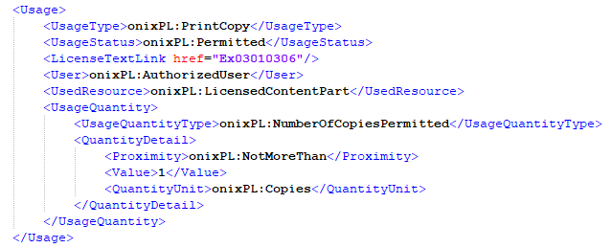
Create an Alma license by importing an ONIX-PL license
The PrintCopy value in input file for “Print copy” in Alma.

Slide 19
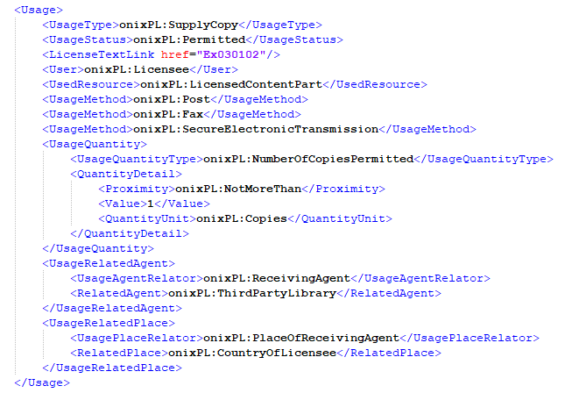
Create an Alma license by importing an ONIX-PL license
The SupplyCopy value in input file for “Scholarly sharing” in Alma.

Slide 20
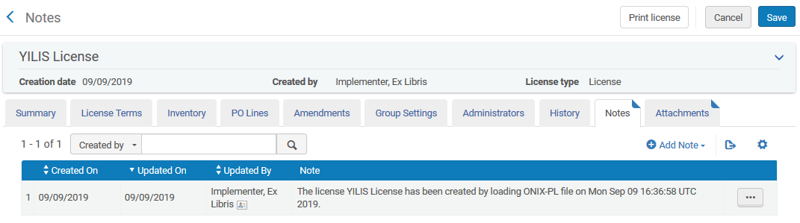
Create an Alma license by importing an ONIX-PL license
The license notes include an indication that the license was created from an ONIX PL input file

Slide 21
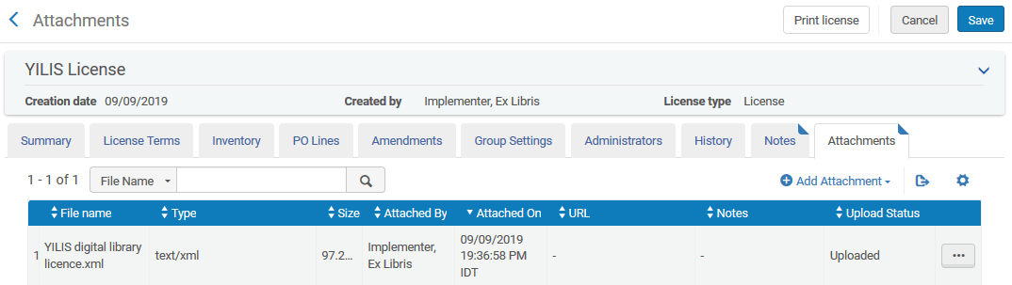
Create an Alma license by importing an ONIX-PL license
The license attachments include the ONIX PL input file that was used to create the license

Slide 22
Yoel.Kortick@exlibrisgroup.com

